Slide 1
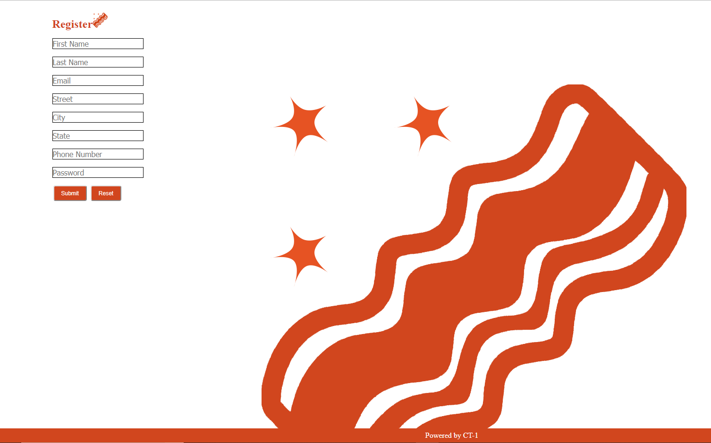
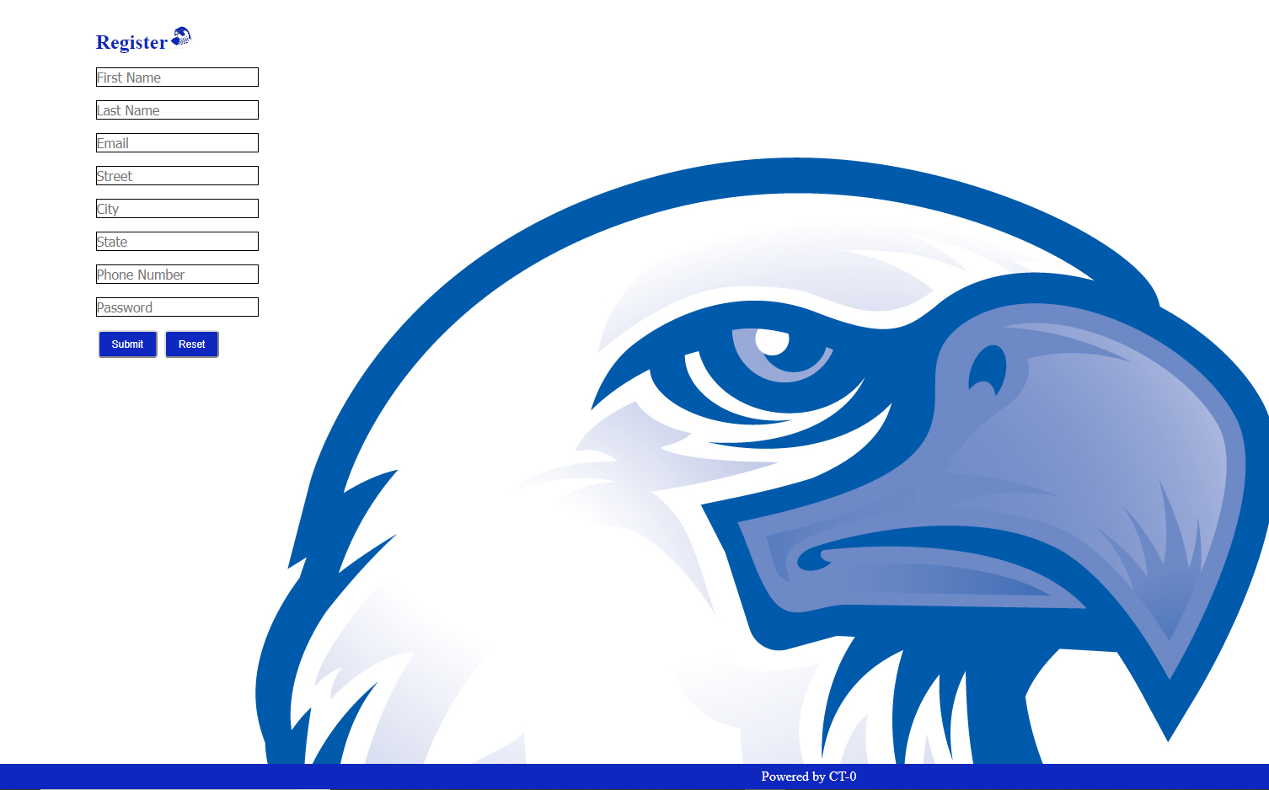
Front-End
Iterative Process
Reevaluate Goals and Customer Needs
Deliver working products
Avoid Project Creep
ASPX
Pros and Cons
HTML and CSS

Slide 2
docs.microsoft.com system.web.ui.webcontrols.button
w3schools.com

